Slide 1
Neuromorphic Computing Models
A Brief Overview

Slide 2
Basics
Based on Artificial Neural Network (ANN) concept
Third generation neuron simulation
Developed to simulate biological functions - not for machine learning
Neuromorphic computing has been shown to be viable for computing

Slide 3
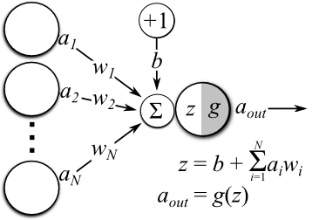
ANNs
Machine Learning Technique
Inputs are modified by weights
Neurons sum inputs and apply output function
Output is the result of the function

Slide 4

Spiking Neural Networks
Discrete Time
Outputs are binary
Activation Function can be complex
Neurons do not need to fire at every time step, $t$

Slide 5
Introductions
First scientific model developed in 1952 by Hodgkin and Huxley

Slide 6
Current Hardware
Current Hardware uses spiking neurons
Integration is generally simple (no sigmoid functions yet)
Significant research on hardware is underway

